Slide 1
The story behind Taobao
Ding Na Sihan, Kenji

Slide 2
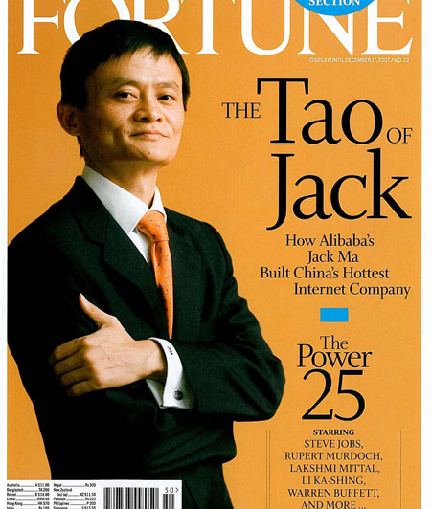
The founder ：Jack Ma
Born October 15, 1964
1988 graduated from Hangzhou Normal University
1993 founded China Yellowpages to building website for company
1999 He founded Alibaba.com , a China-based business-to-business marketplace site
2003 Alibaba group funded taobao.com, based on C2C marketplace site

Slide 3
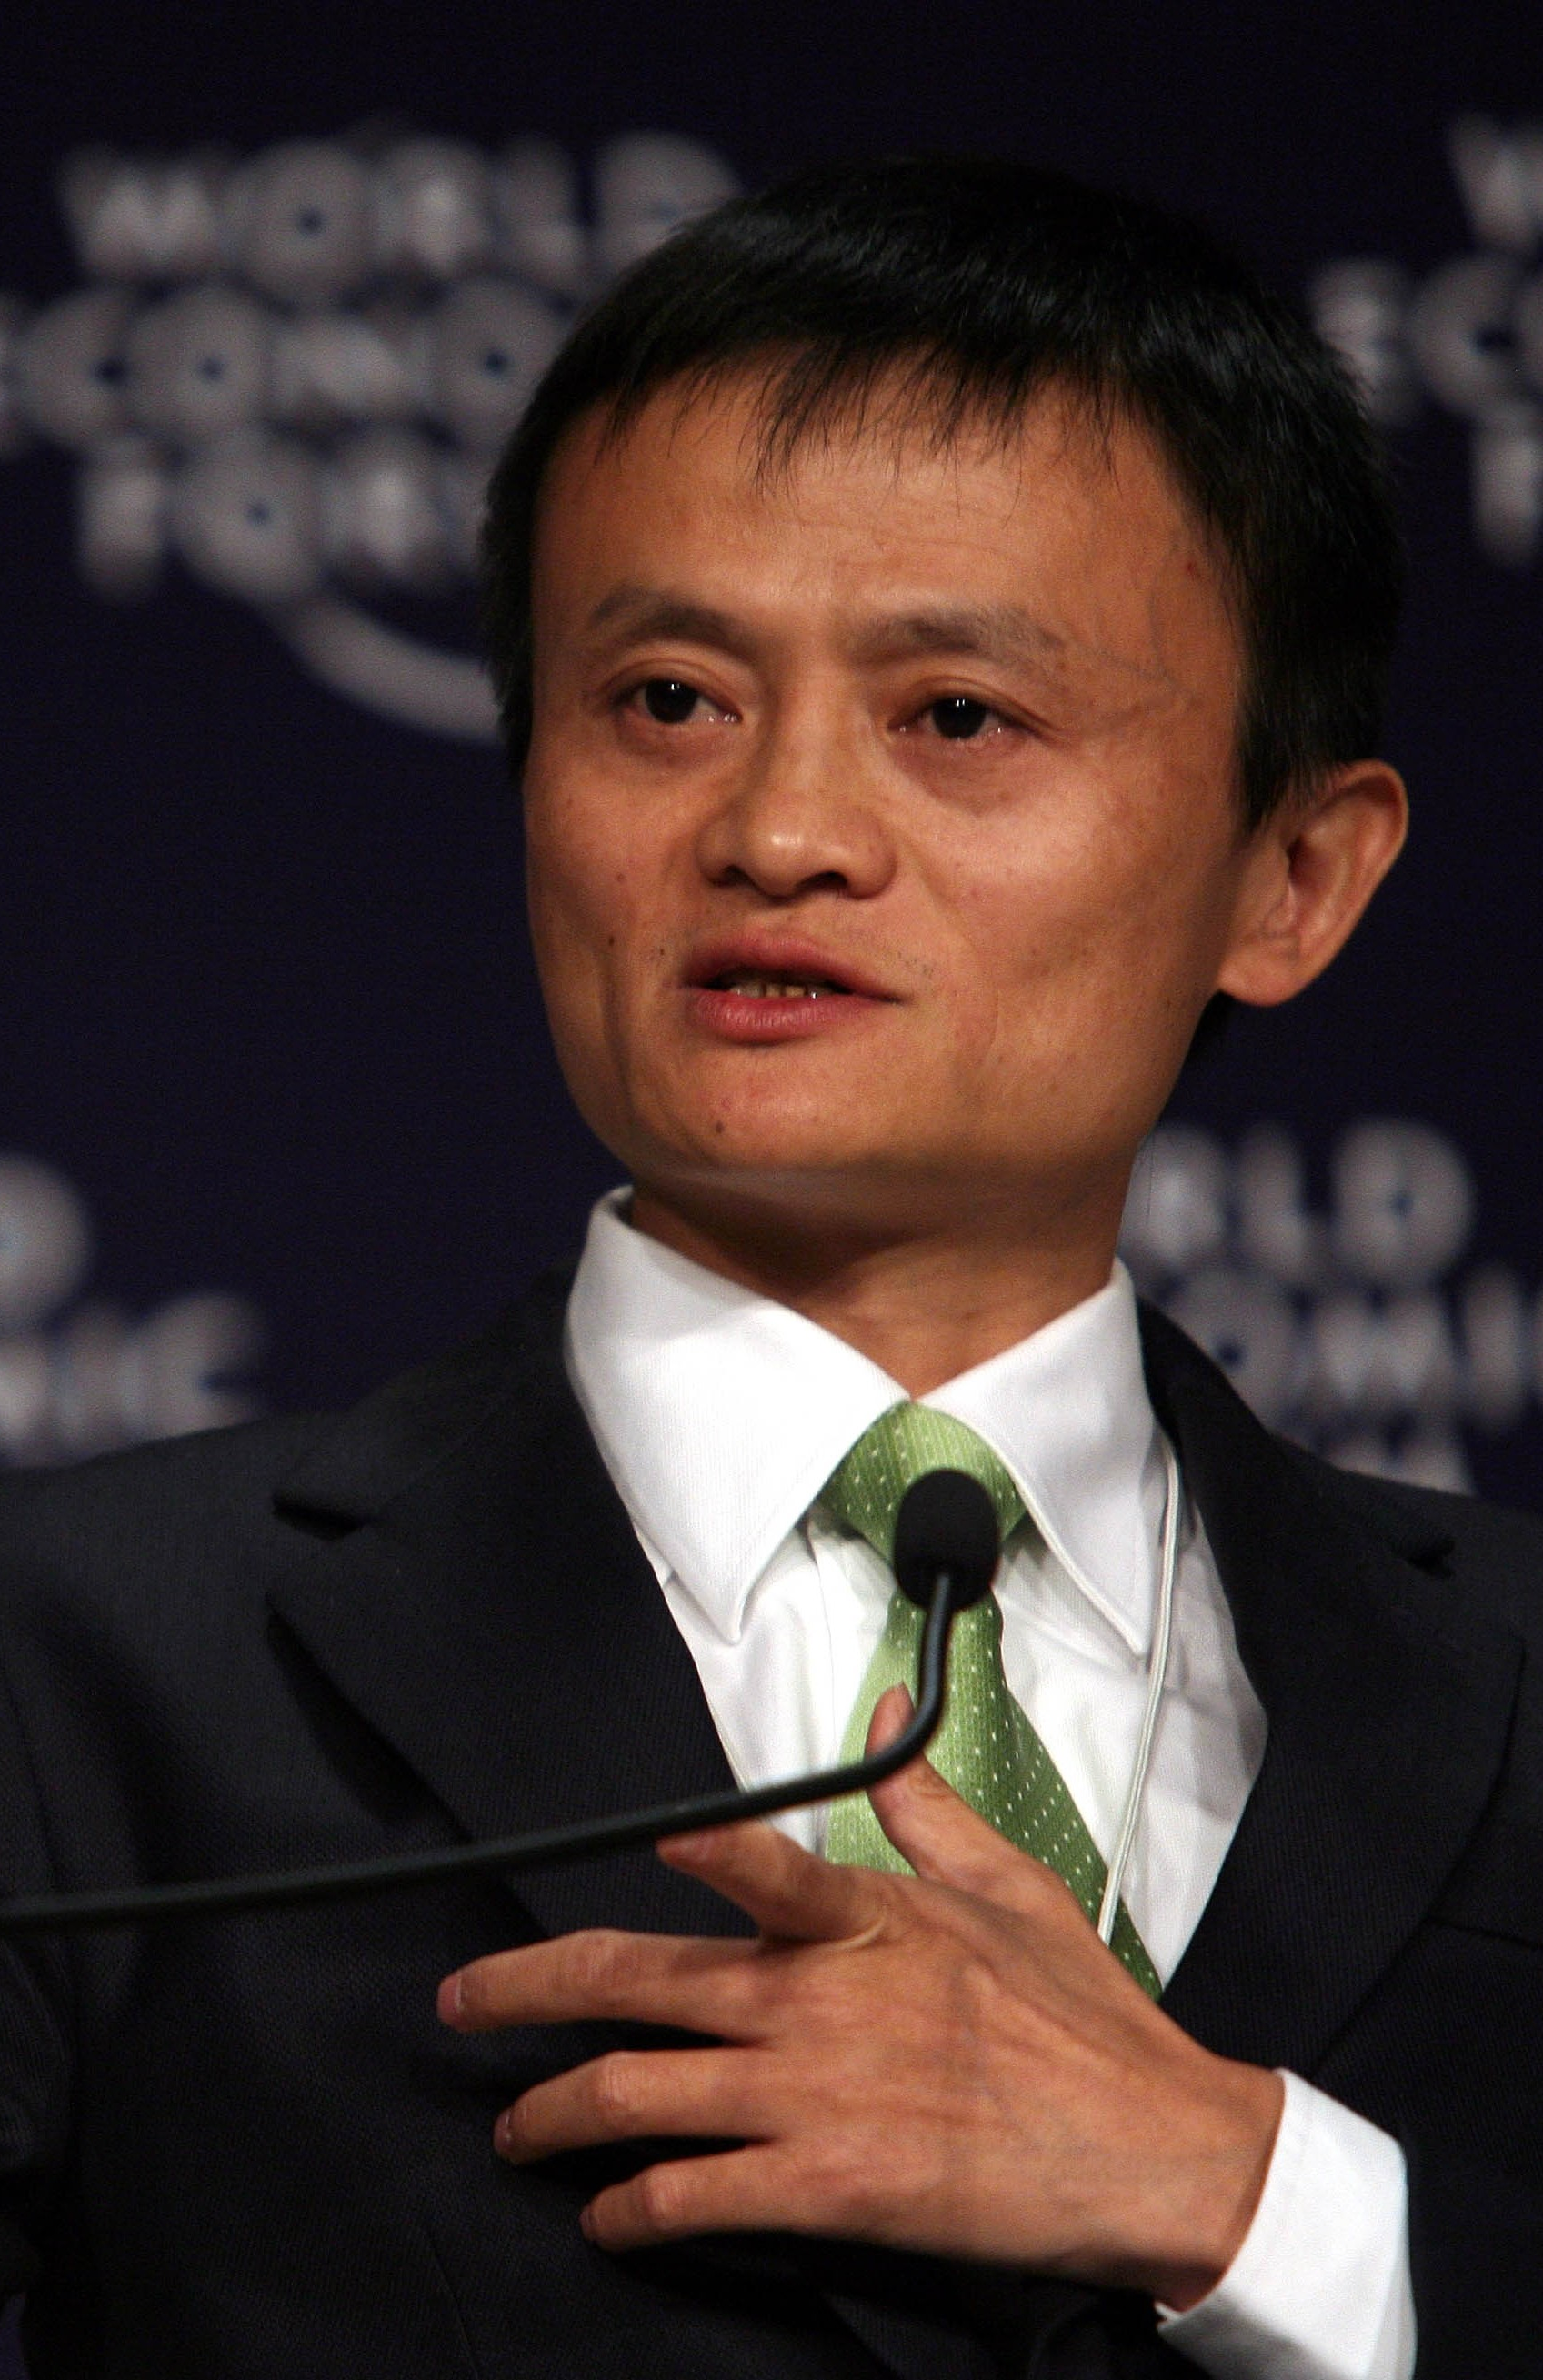

Slide 4
Why Taobao can be successful ?
Search easier than others
Promote the reliable Taobao seller
Good Feedback System
Payment (Alipay)
Communicate with seller
Deal with delivery company

Slide 5
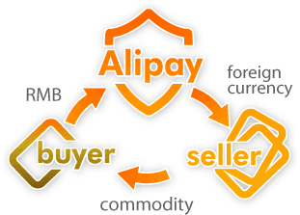
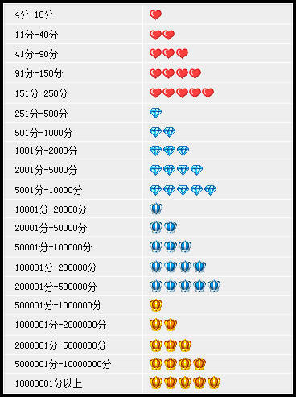
Taobao = Amazon + eBay + Facebook

Slide 6
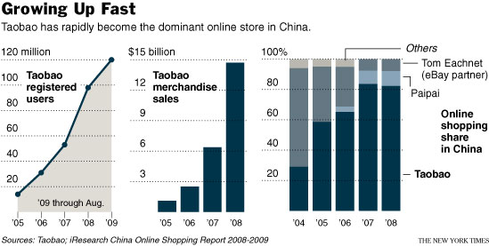
The registered users of Alipay
6 years =180 times
The growth of
Taobao

Slide 7
Gross merchandise volume (GMV) of Taobao Marketplace and tmall.com
Nov11, 2011 8 minutes = 100millions RMB. 24h= 3.36 billion RMB
Nov11, 2012 8h= 5 billion RMB. 24h= 19.1 billion RMB
Nov11, 2013 6 minutes =1 billion RMB. 24h= 35 billion RMB
2011 1 year = 610 billion RMB
2013 1year = over 1000 billion RMB

Slide 8
Breaking news
Chinese Internet company Alibaba filed its plans for a $1 billion initial public offering. Many had speculated the company would raise more than that. The company did say it might increase the size of its IPO as the process continues before being priced.
Internet IPO Date Deal Size $ billions
Facebook 5/17/2012 $16.0
Twitter 11/6/2013 $1.8
Google 8/18/2004 $1.7
Yandex 5/23/2011 $1.3
Infonet 12/15/1999 $1.1
Source: Renaissance Capital
$15 ~$20

Slide 9
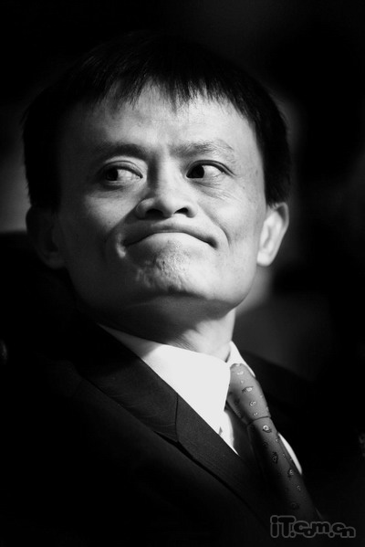
“Man's looks and his talent is always inversely proportional ”(男人的相貌和才华往往成反比）
–Jack Ma

Slide 10
Thanks for your attention

